Slide 1
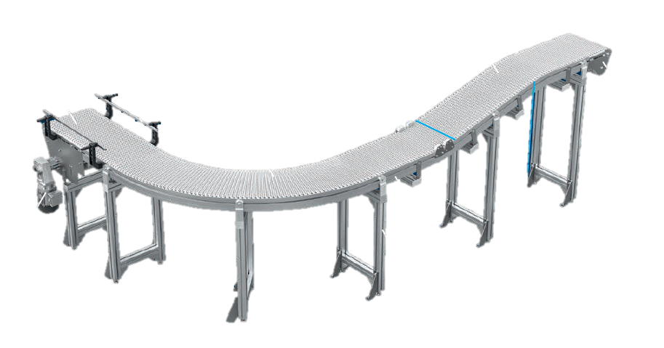
VarioFlow belt
Library development in Visual Components
24.02.25

Slide 2
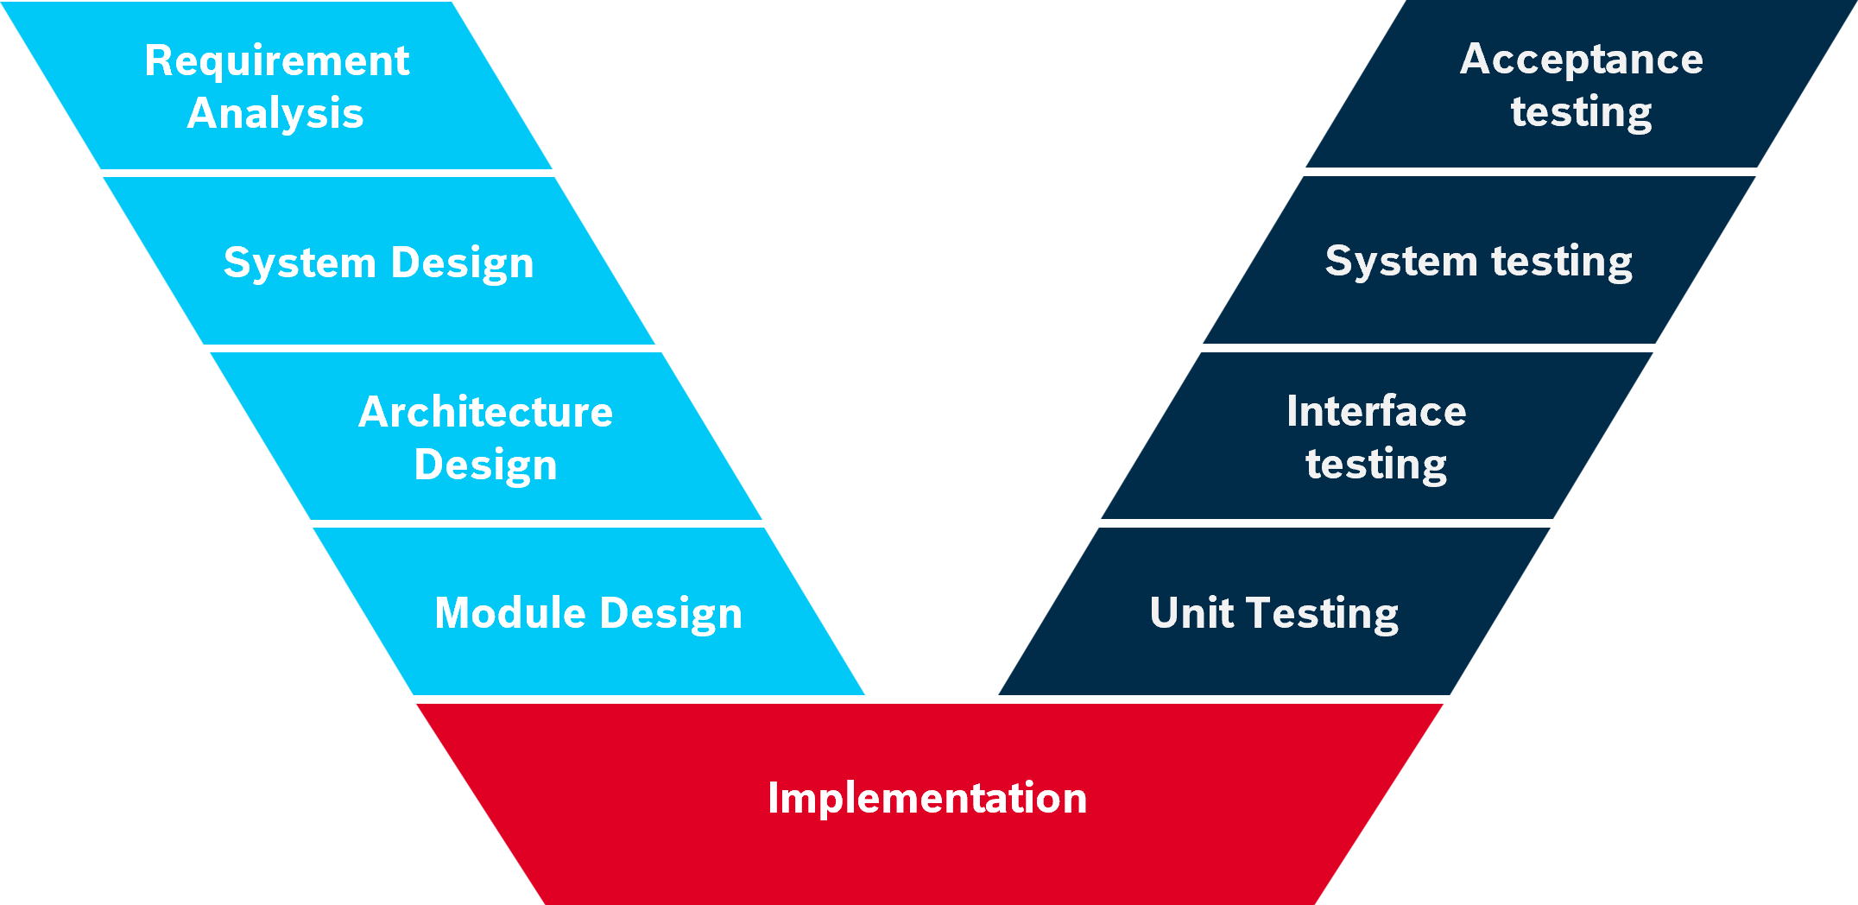
Overview
Library Development of VF belt Components
Specifications of simulation components
Testing
Provide models to Visual components
Evaluation of product information
Planning of development
Modelling
Release
V-Model Framework for System development
01/2025
Completed
Exporting CAD files from MTPro
Component / behavior modelling in VC
02/2025
Used VF library as a reference.
Creating basic testing models
02/2025
Completed

Slide 3
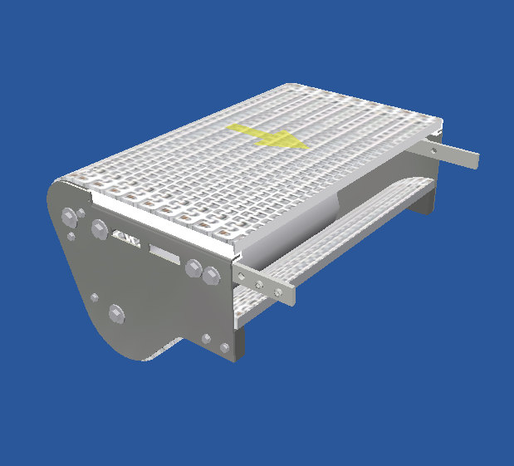
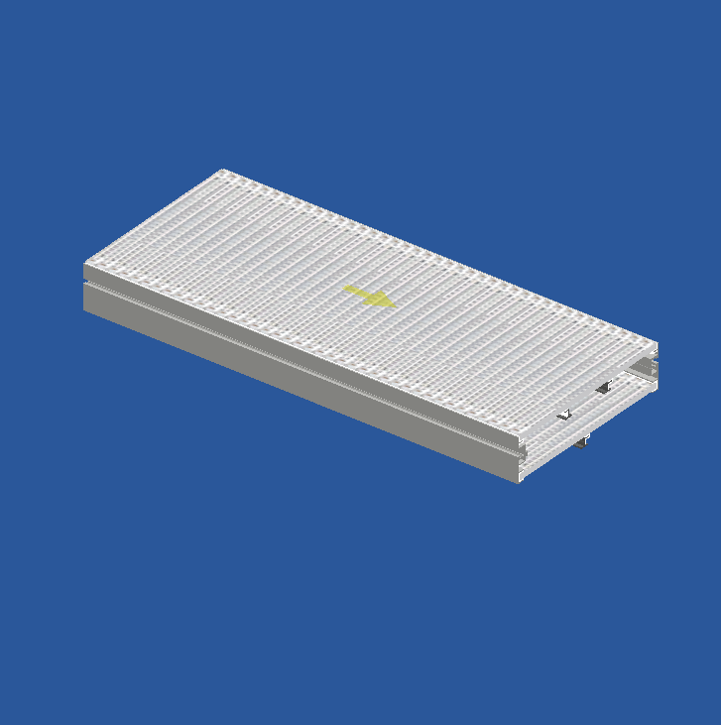
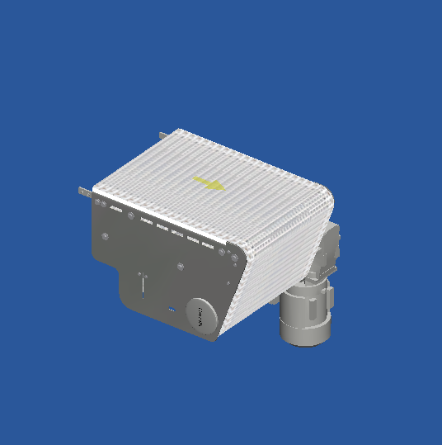
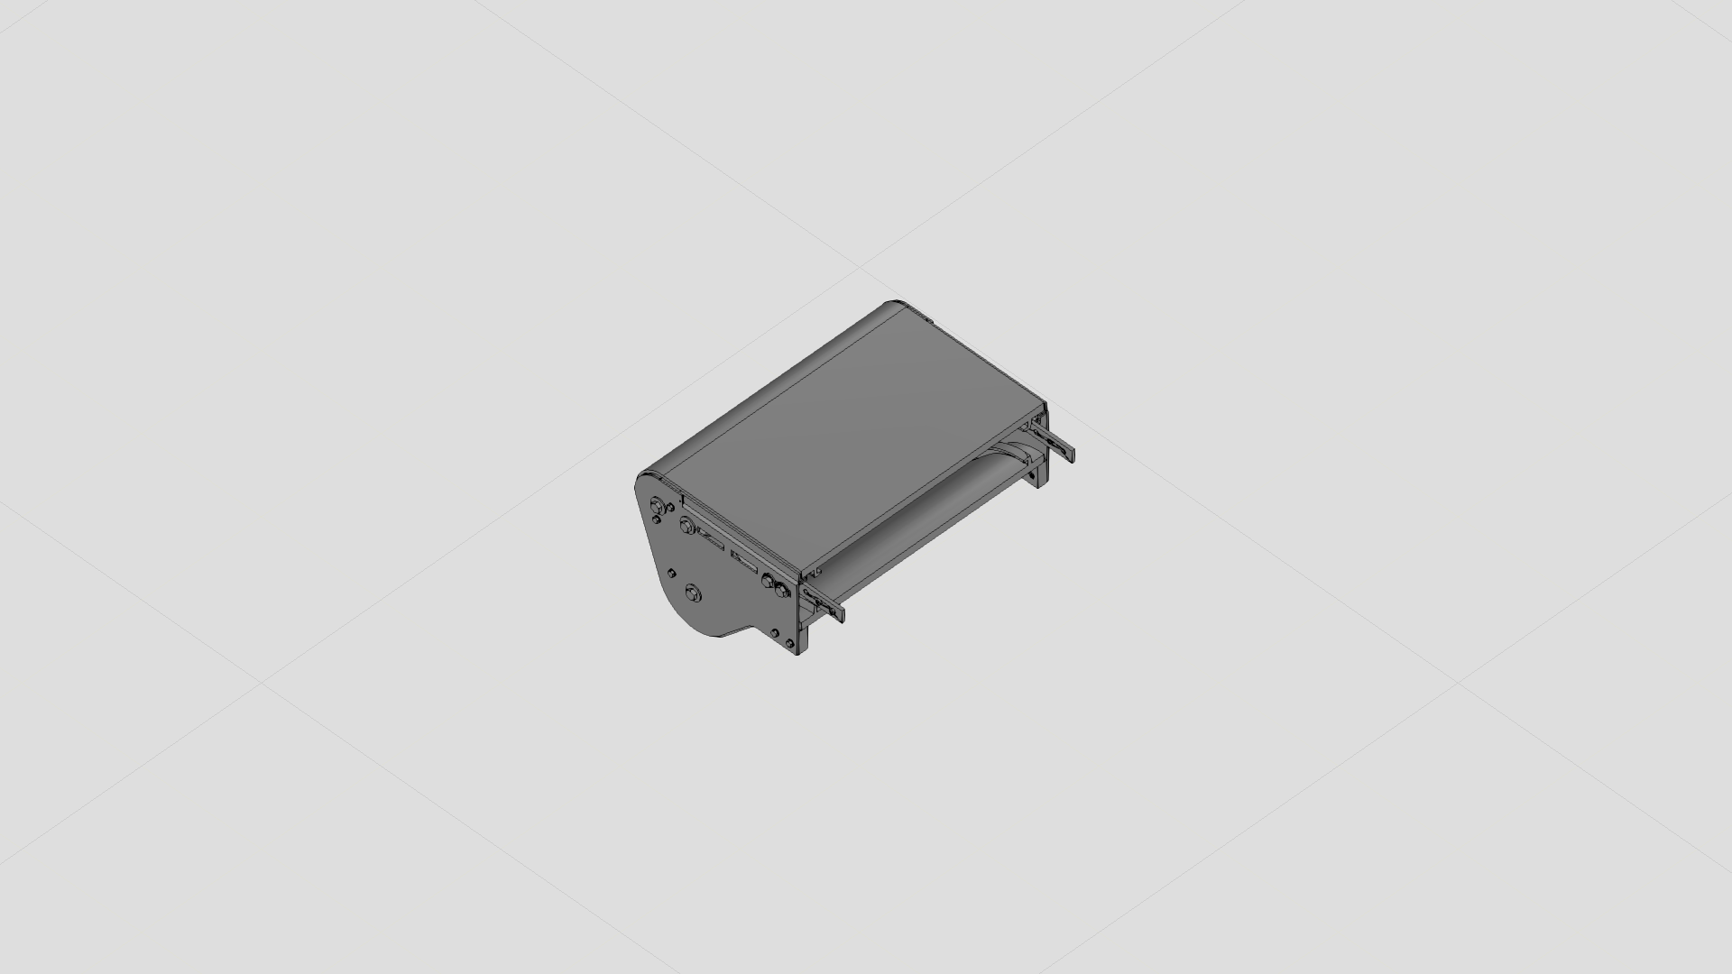
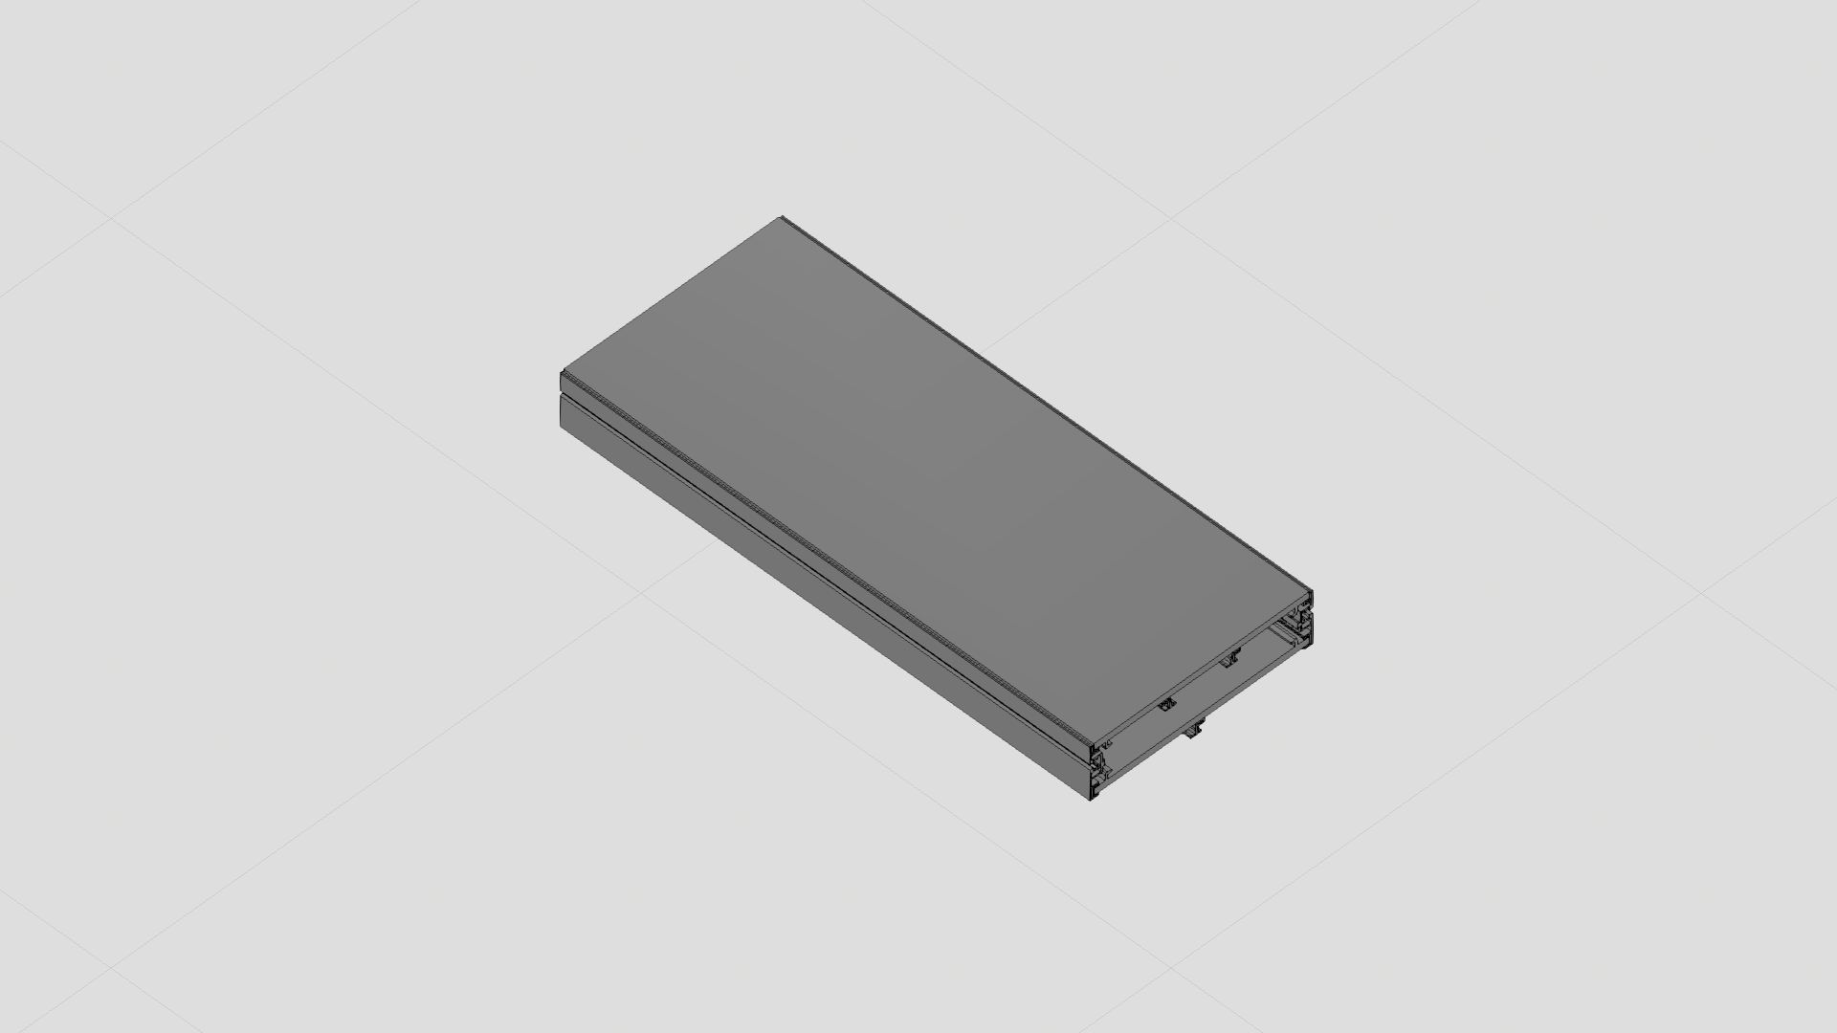
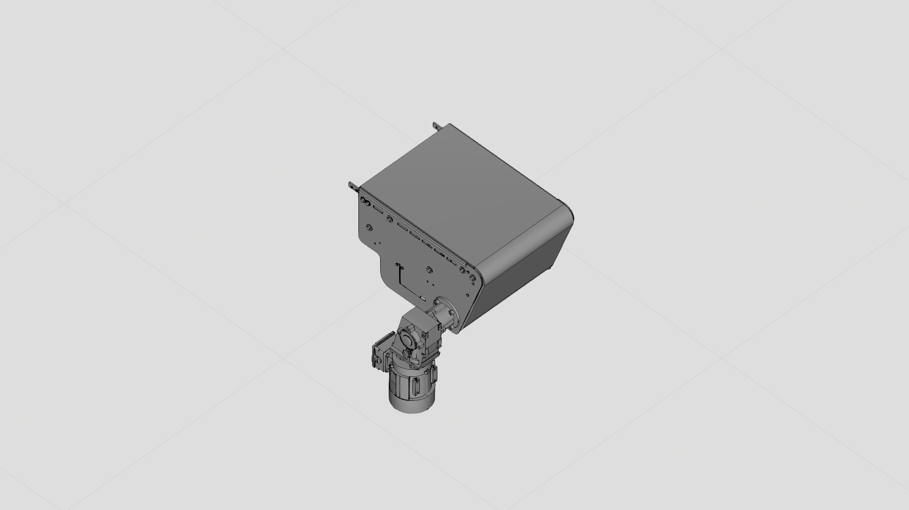
Planned Components from MTPro & Modelled Component in VC
Library Development of VF belt Components
Component in MTPro
Return Unit
Section
Drive
Modelled Component in VC

Slide 4
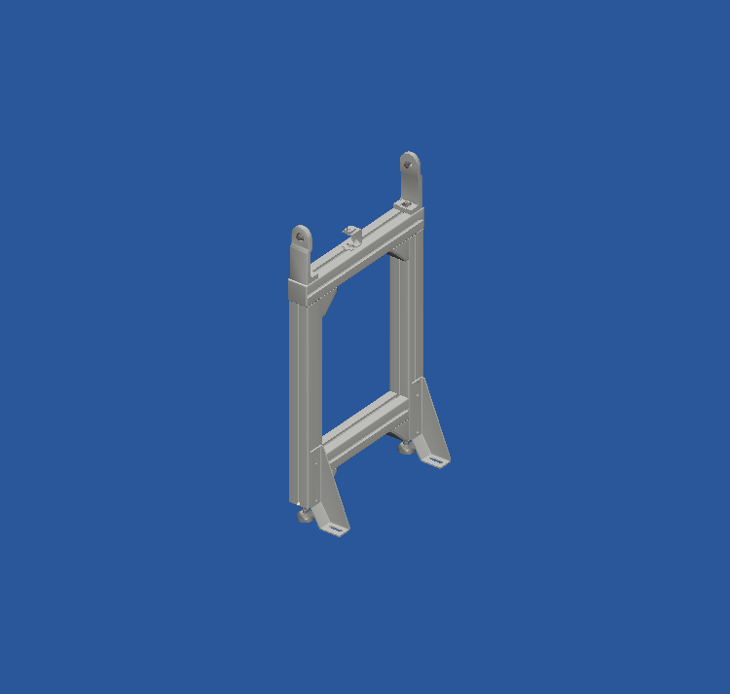
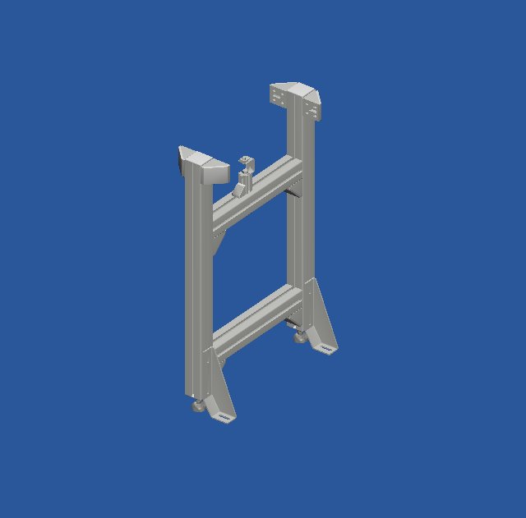
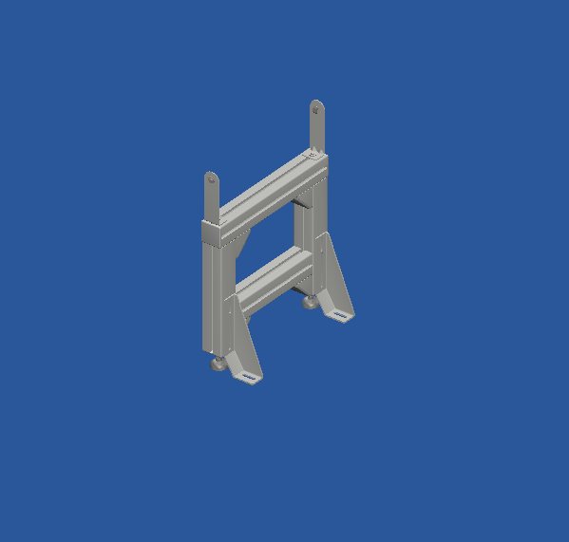
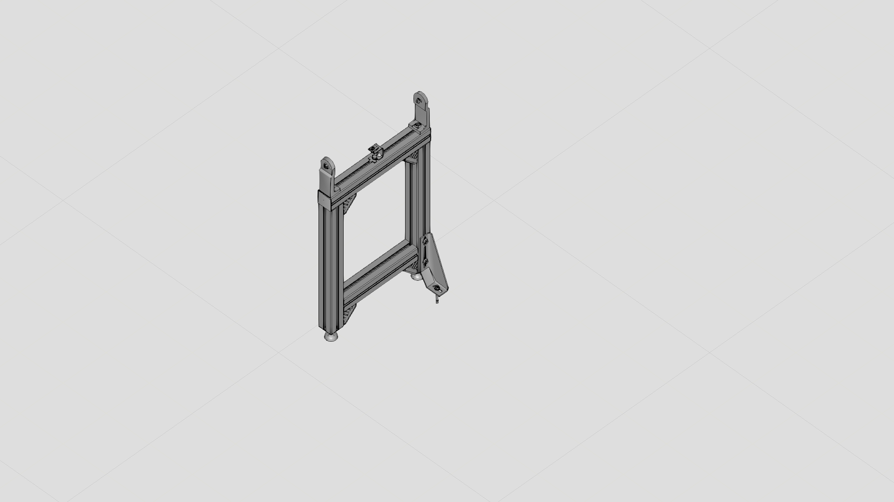
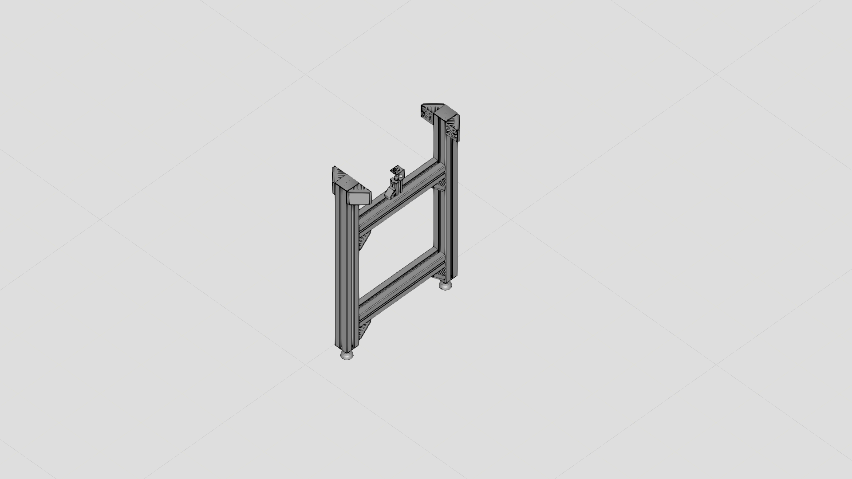
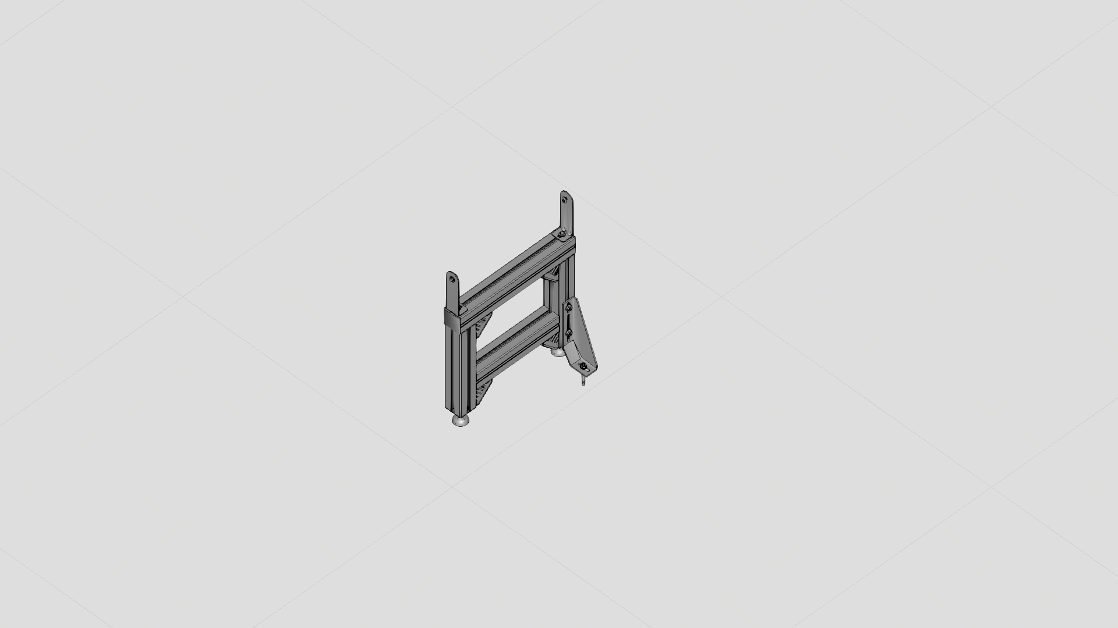
Planned Components from MTPro & Modelled Component in VC
Library Development of VF belt Components
Component in MTPro
Legset-Flat belt
Legset-Static Friction belt
Legset for drive unit
Modelled Component in VC

Slide 5
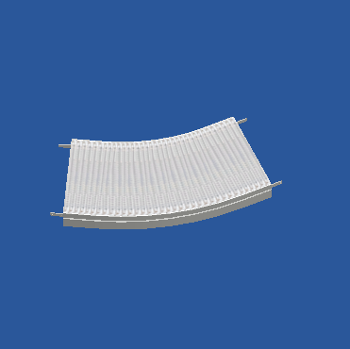
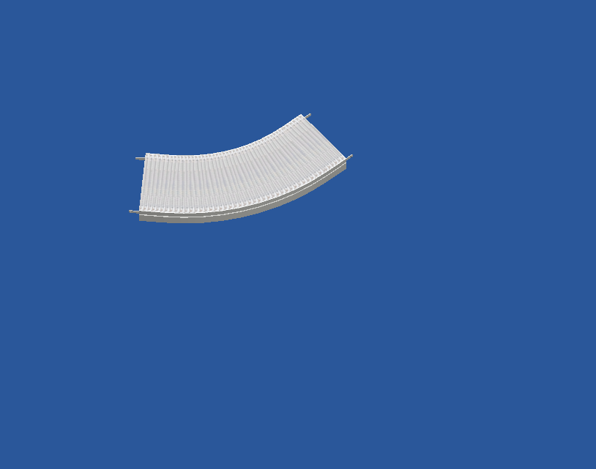
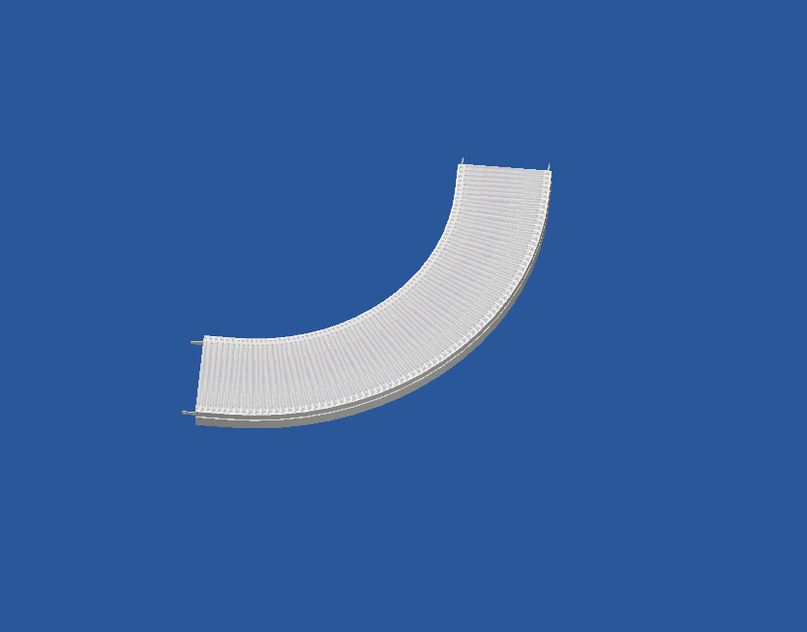
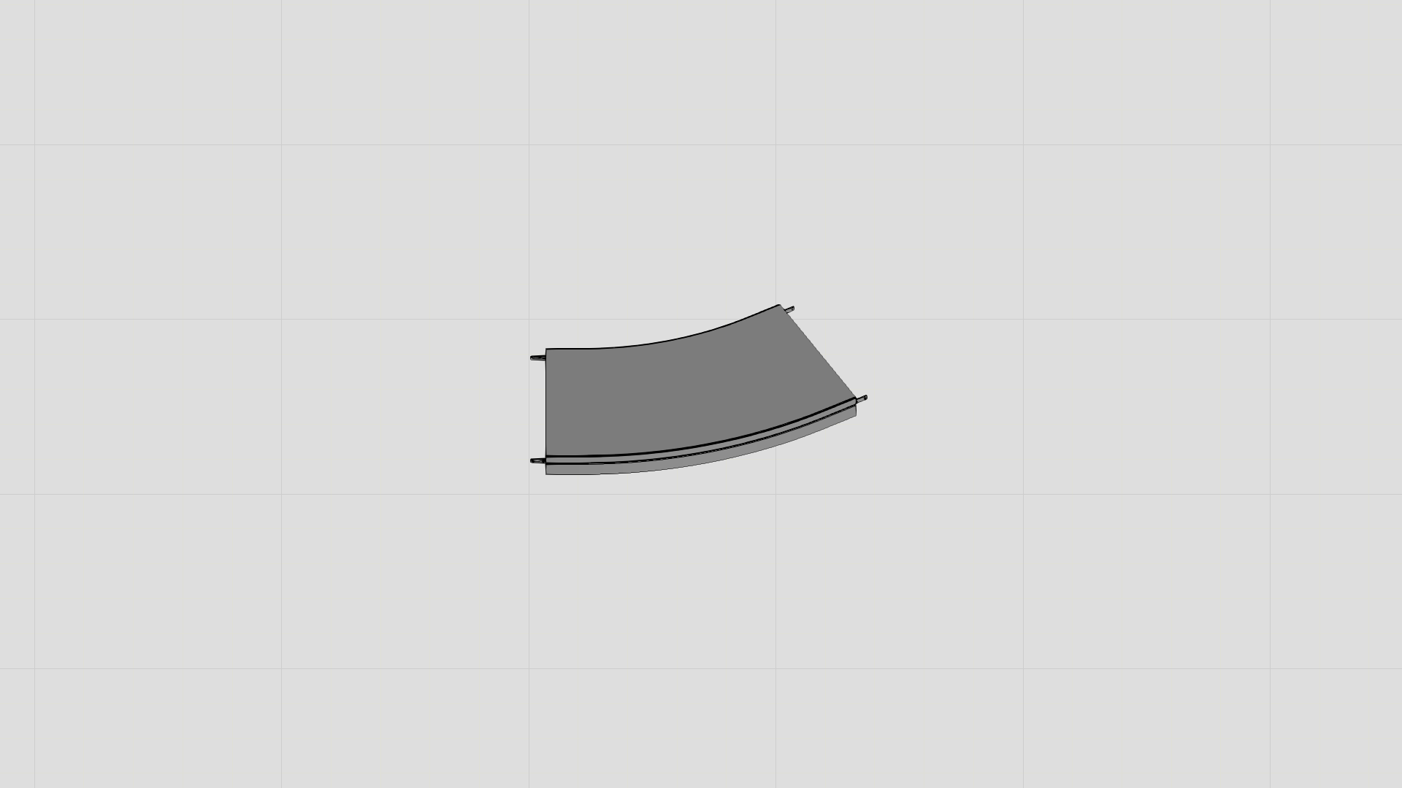
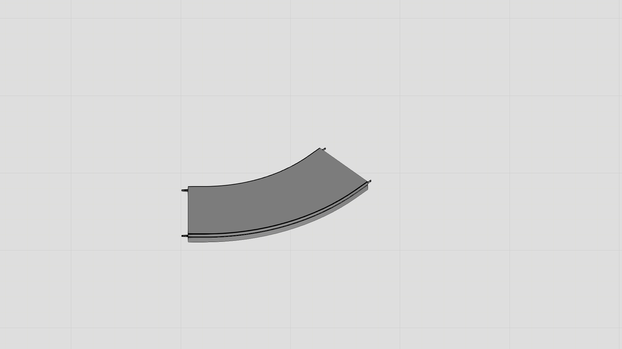
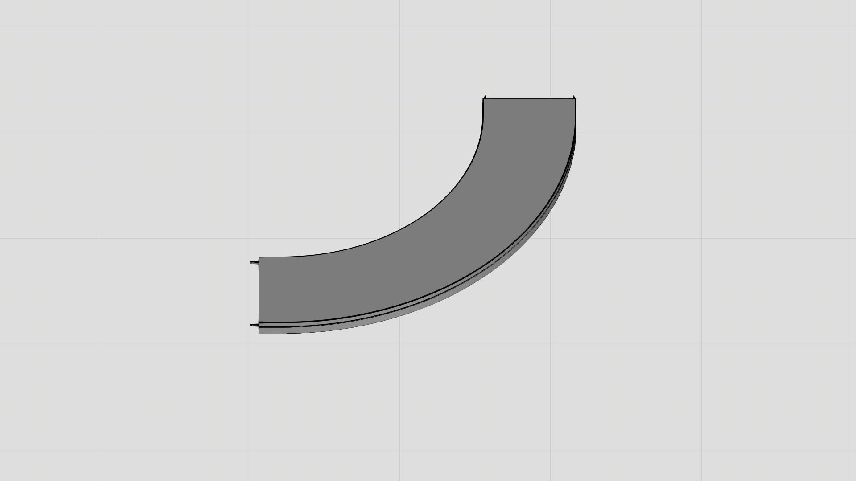
Planned Components from MTPro & Modelled Component in VC
Library Development of VF belt Components
Component in MTPro
Horizontal Curve (30°)
Horizontal Curve (60°)
Horizontal Curve (90°)
Modelled Component in VC

Slide 6
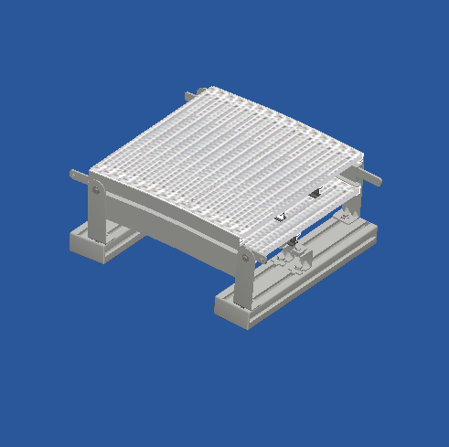
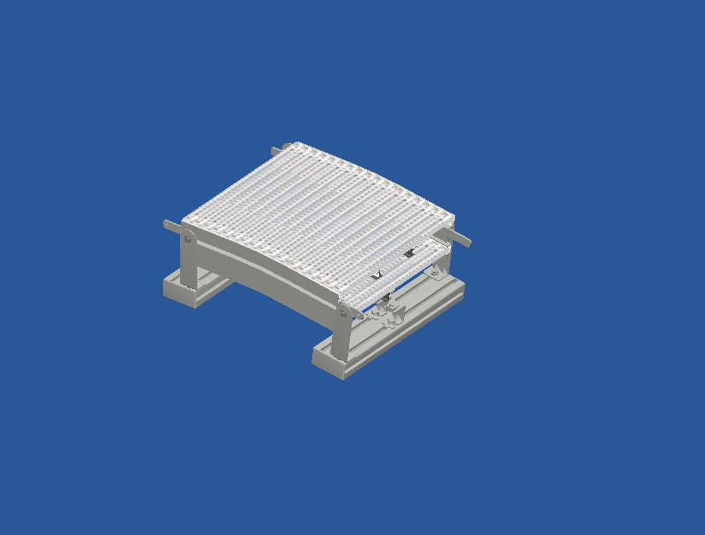
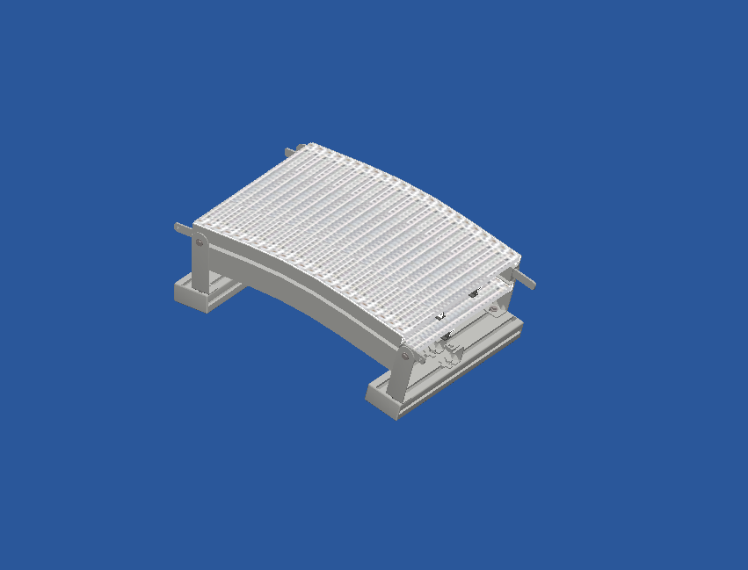
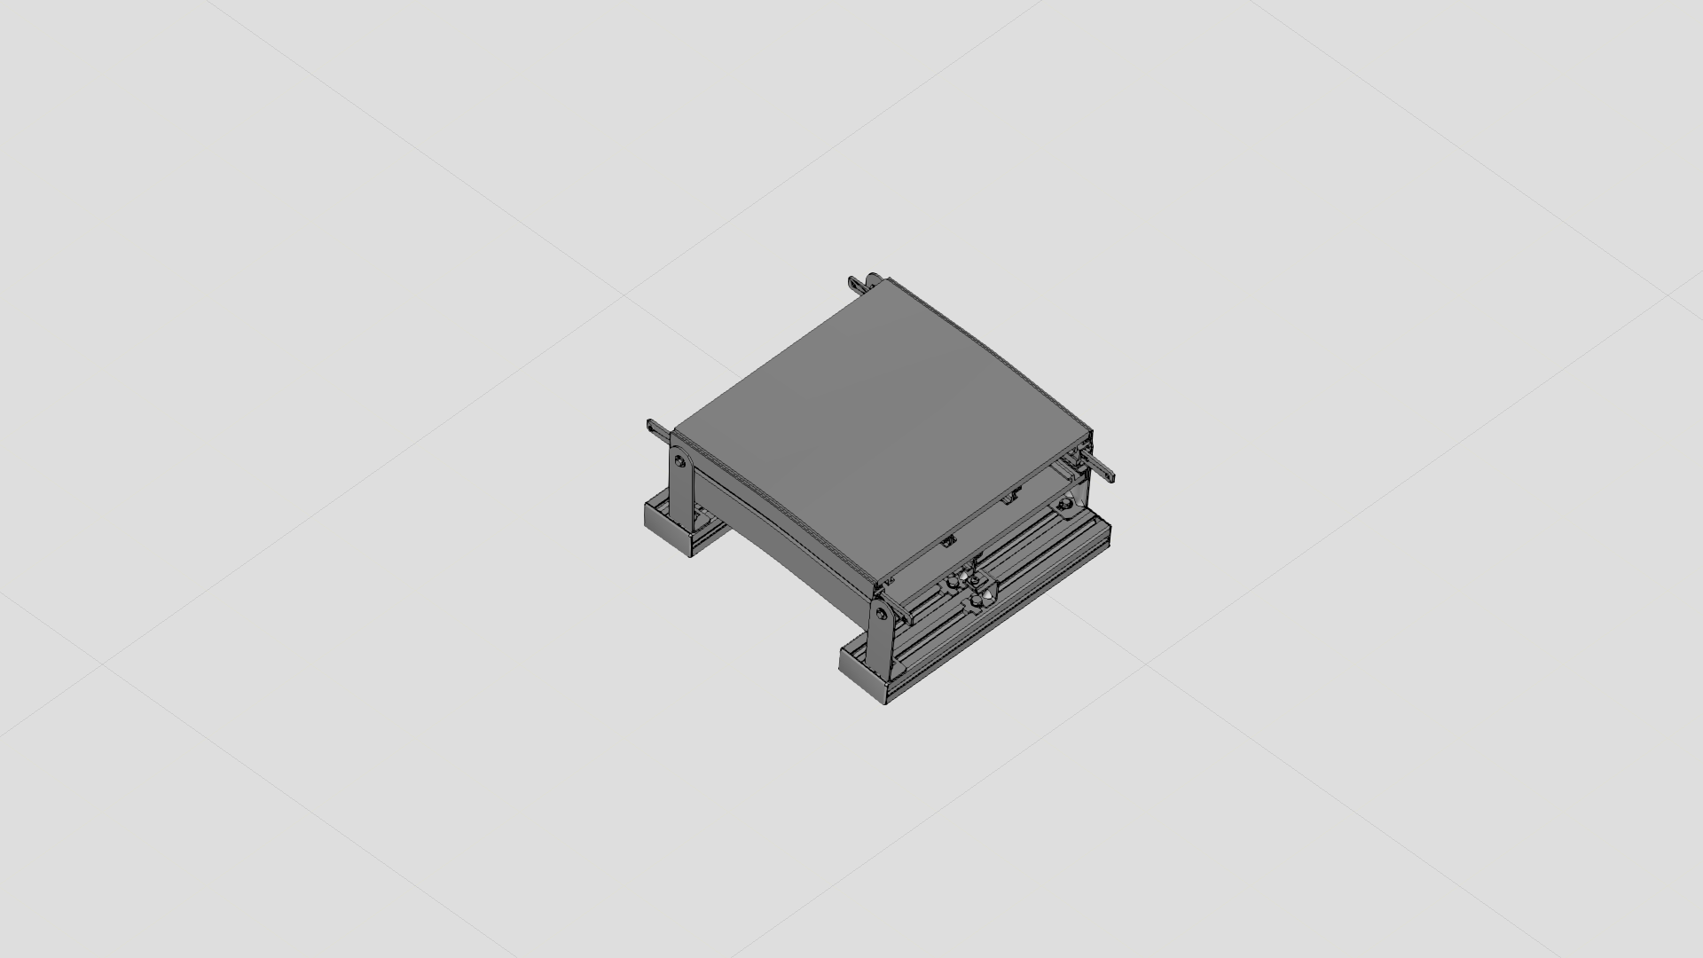
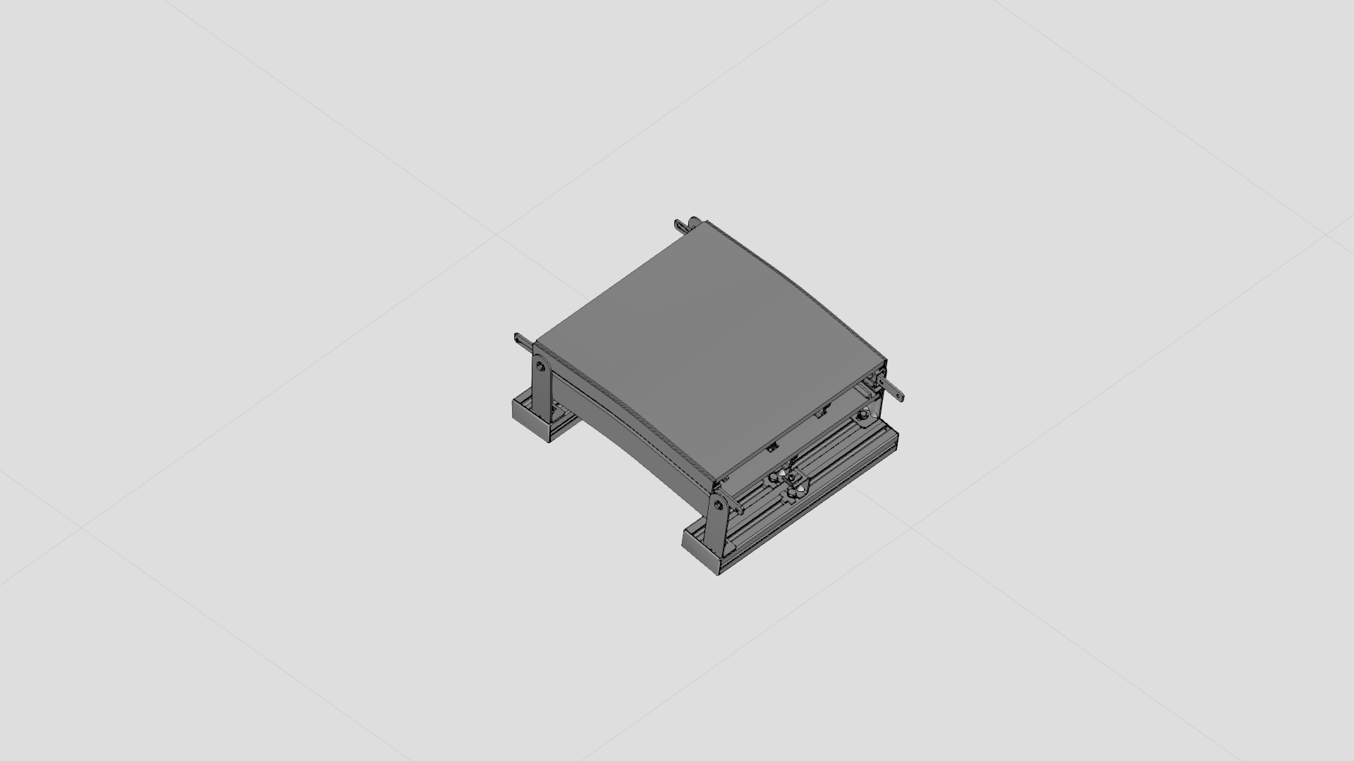
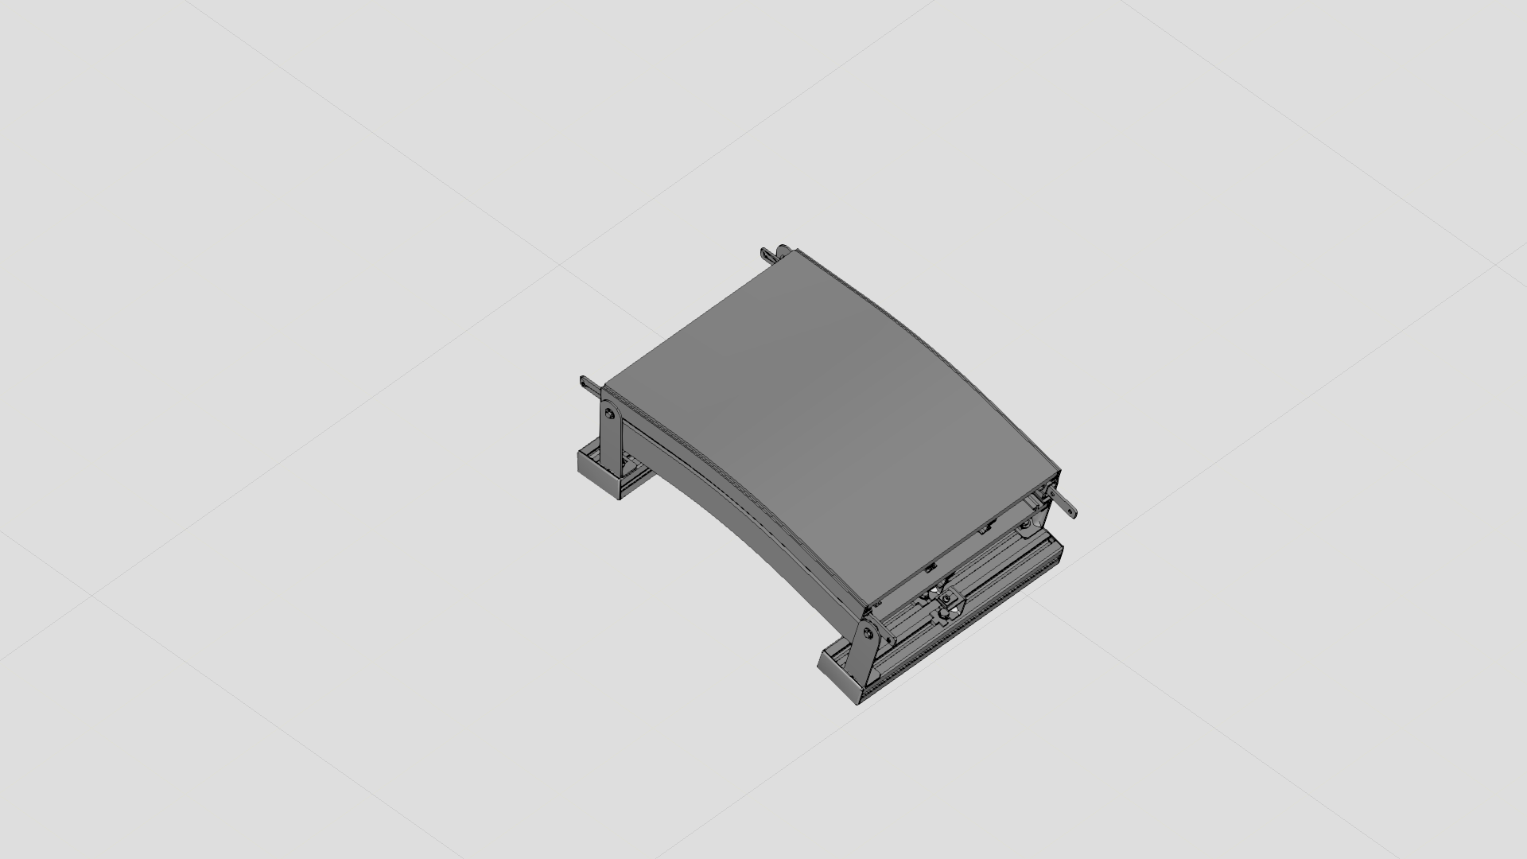
Planned Components from MTPro & Modelled Component in VC
Library Development of VF belt Components
Component in MTPro
Vertical Curve (5°)
Vertical Curve (7.5°)
Vertical Curve (15°)
Modelled Component in VC

Slide 7
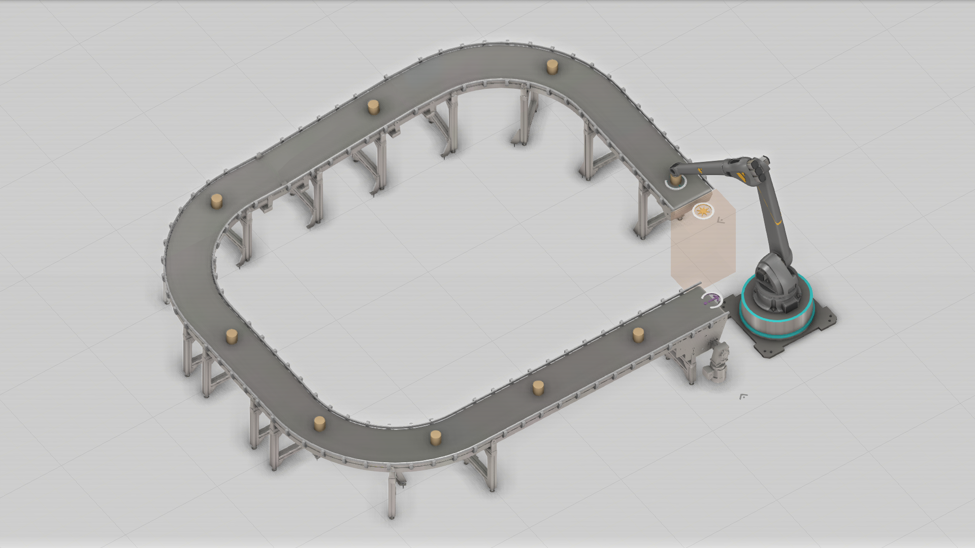
Basic testing model
Library Development of VF belt belt Components

Slide 8
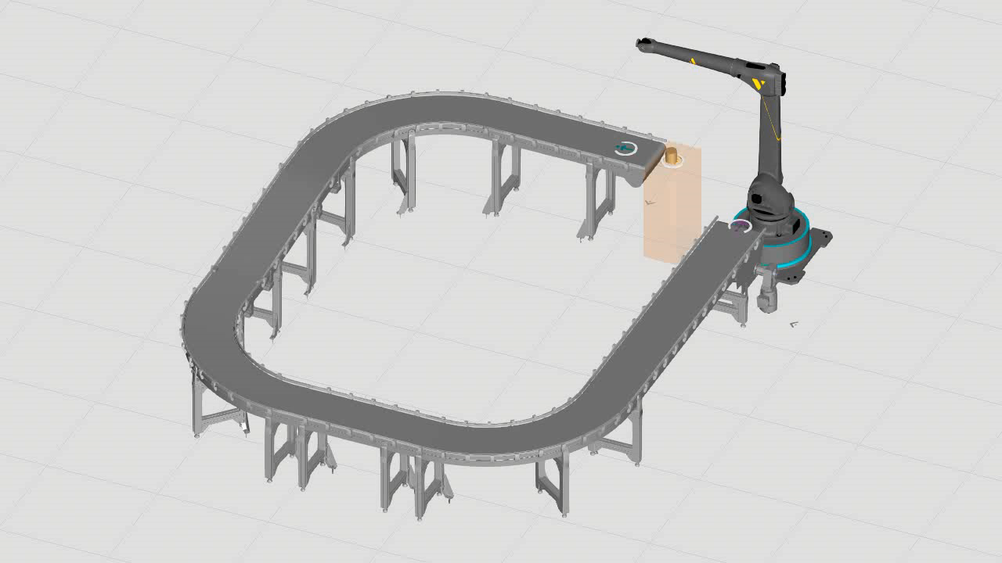
Basic testing model
Library Development of VF belt belt Components

Slide 9
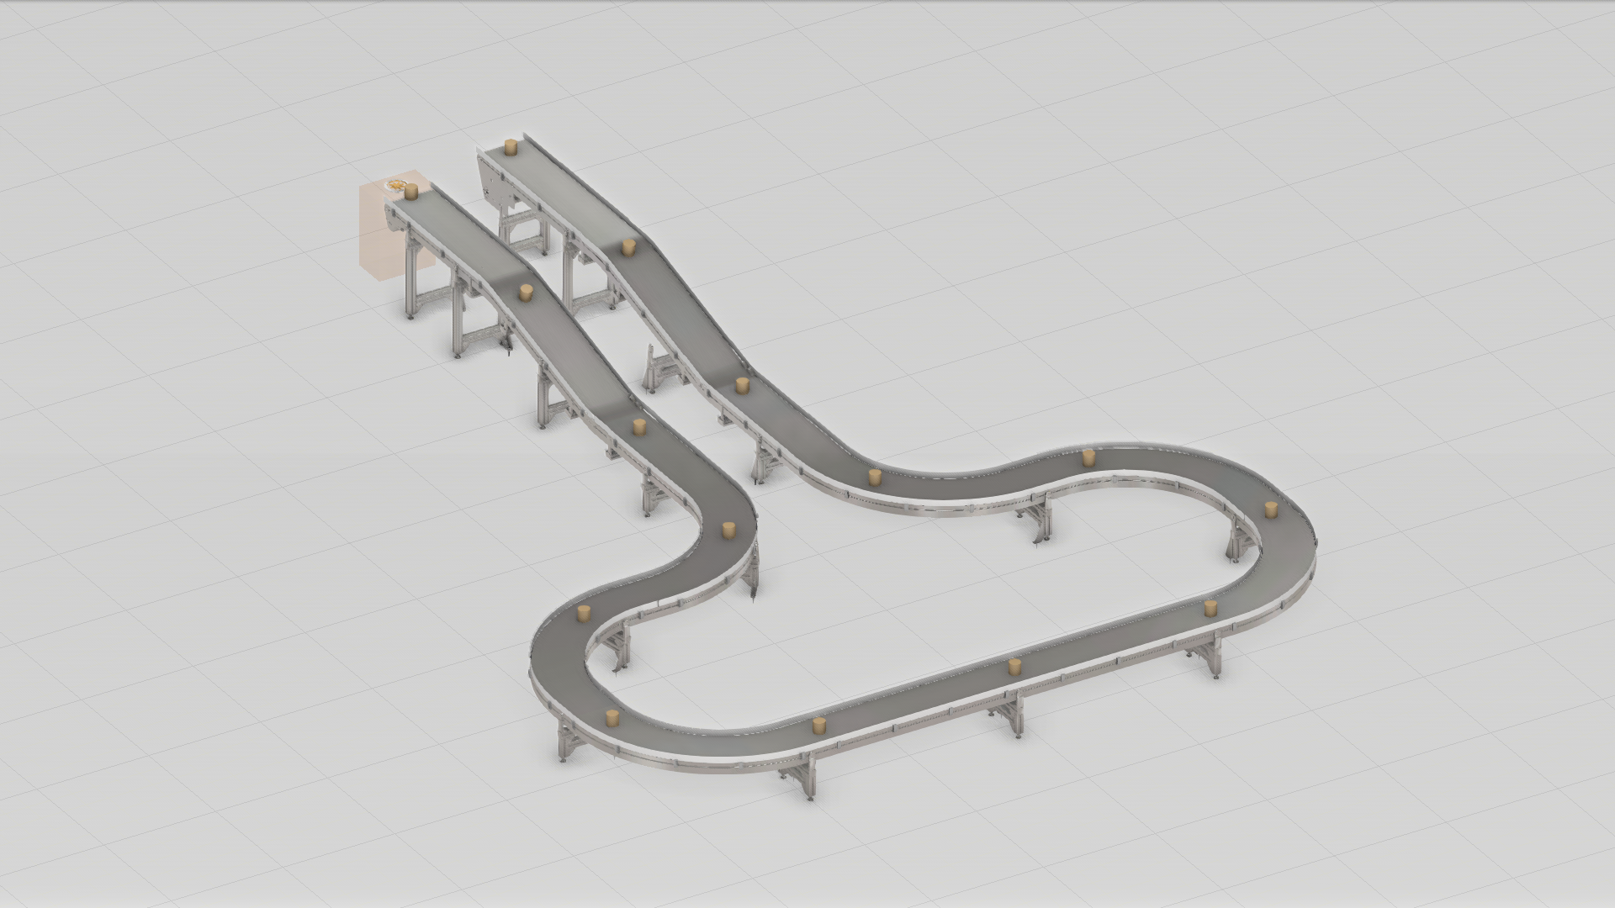
Basic testing model
Library Development of VF belt belt Components

Slide 10
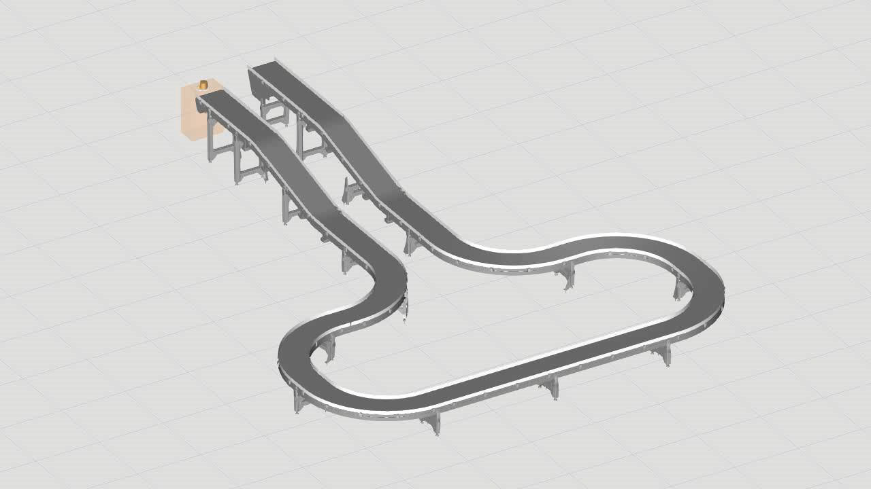
Basic testing model
Library Development of VF belt belt Components

